Slide 1

Harmonizing Insights: A Comprehensive Analysis of Spotify Songs Data for Enhanced Musical Experiences

Slide 2
Enhancing Musical Experience Through Data Analysis
Objective: Conducting in-depth analysis of Spotify song data to understand factors influencing musical tastes, with a focus on the emotional spectrum.
Identified Issue: Numerous factors affect music consumption, particularly emotions. Understanding these nuances is crucial as music can evoke diverse emotions.
Challenges: Recommendation systems and advertising agencies face complexities in understanding incomplete articulations of musical preferences.
Approach: Our analysis delves deep into the intricate factors shaping musical experiences, including rhythm, lyrics, and melody, to unravel patterns in Spotify songs data.

Slide 3
Research Questions
Descriptive Question: What are the primary factors influencing an individual's choice of music on Spotify, and how do these factors vary across different demographics and regions?
Prescriptive Question: Given the predicted shifts in musical preferences, what actionable recommendations can be provided to the Spotify team to enhance user satisfaction and engagement, and how can these recommendations be personalized for different audience segments?
Predictive Question: Based on historical data, what patterns and trends can be identified to predict potential shifts in musical preferences on Spotify over the next year, and how might these trends differ among various user segments?

Slide 4

Analytical Instruments
Our selected tool for this musical journey is R, renowned for its excellence in visualization and analysis. R's versatility perfectly complements the complexity of our investigation, offering a sturdy foundation for unraveling the intricacies within Spotify songs data.
Additionally, we utilized Power BI to craft compelling visual representations.

Slide 5
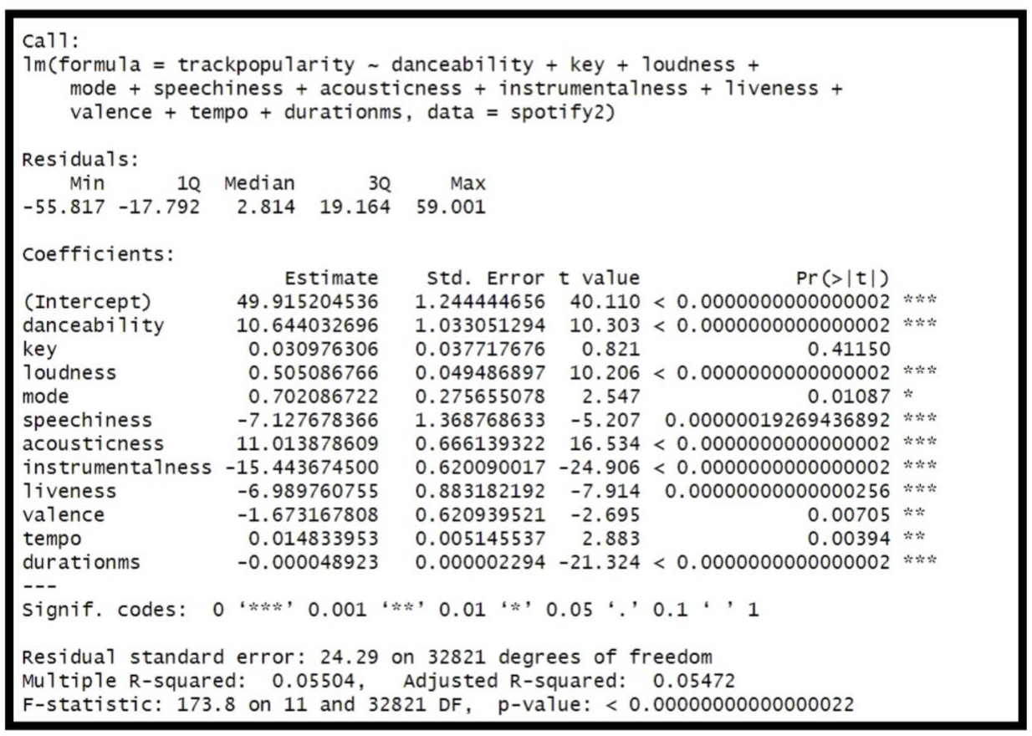
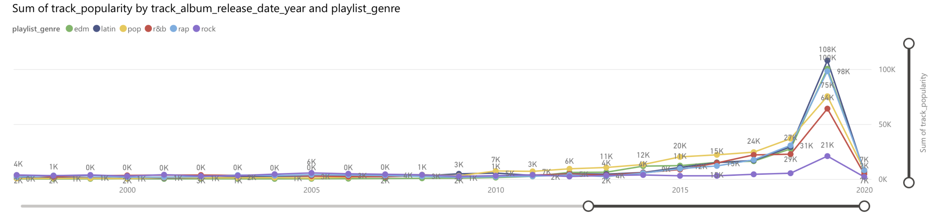
Visual Insights: Unraveling the Musical Landscape

Slide 6
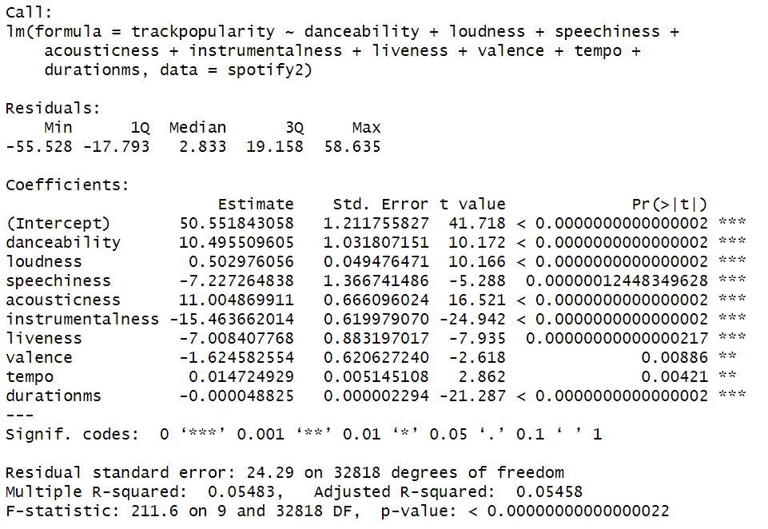
Linear Regression
From the result we can see that all variables have p-values less than 0.05. so, we can say that all variables have a significant relationship with the popularity of the music.
The R-squared value is very low 5%, which tells us 5% of the variation in popularity is explained by all variables present in the model.

Slide 7
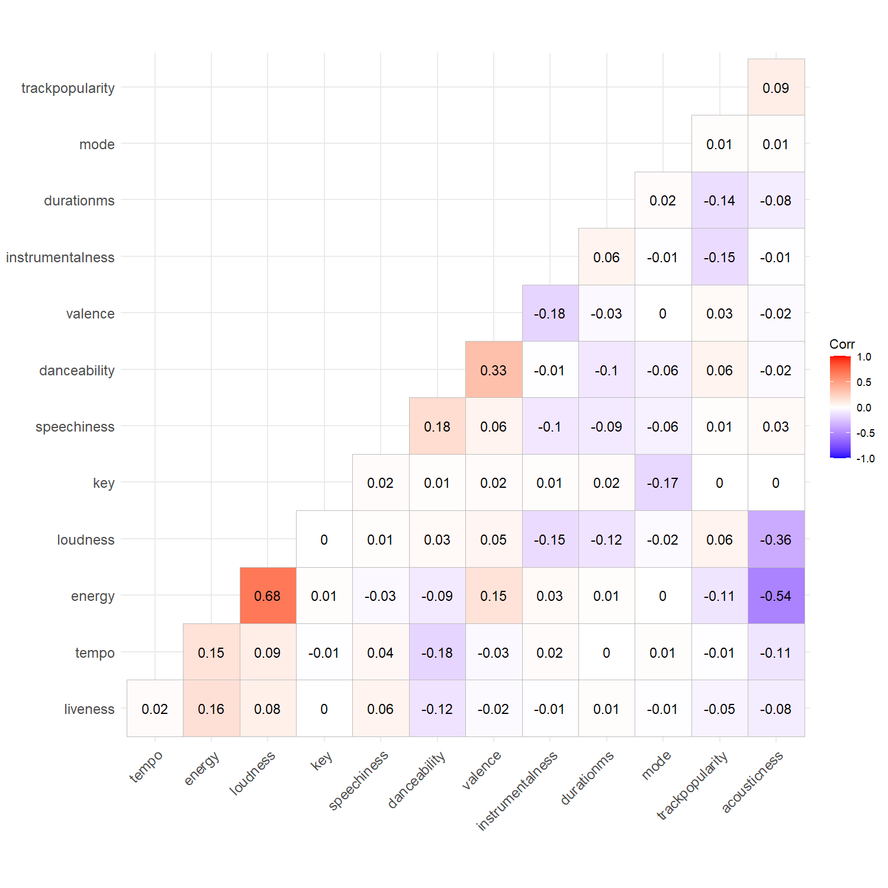
Correlation Test
The correlation test reveals that only energy and loudness have a positive correlation coefficient of 0.68.
Positive correlation indicates that as one variable increases, another variable also increases.

Slide 8
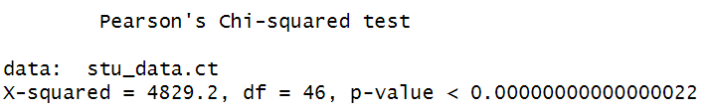
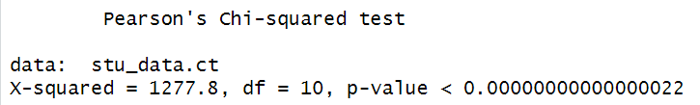
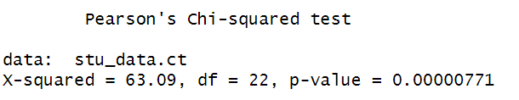
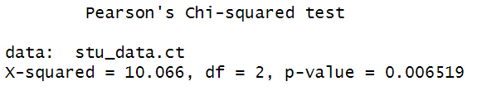
Chi- Square Test
chi-square test to analyze the relationship between `popularity` and `Key` variables.
chi-square test to analyze the relationship between `popularity` and `mode` variables.
chi-square test to analyze the relationship between `popularity` and `playlistgenre ` variables.
chi-square test to analyze the relationship between `popularity` and `playlistsubgenre ` variables.

Slide 9
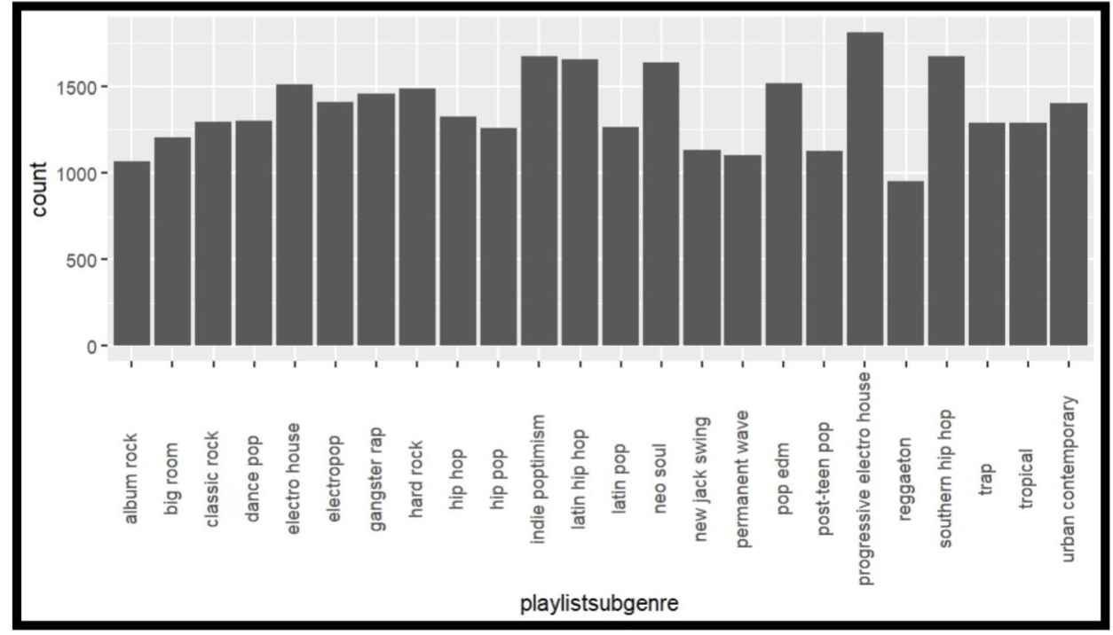
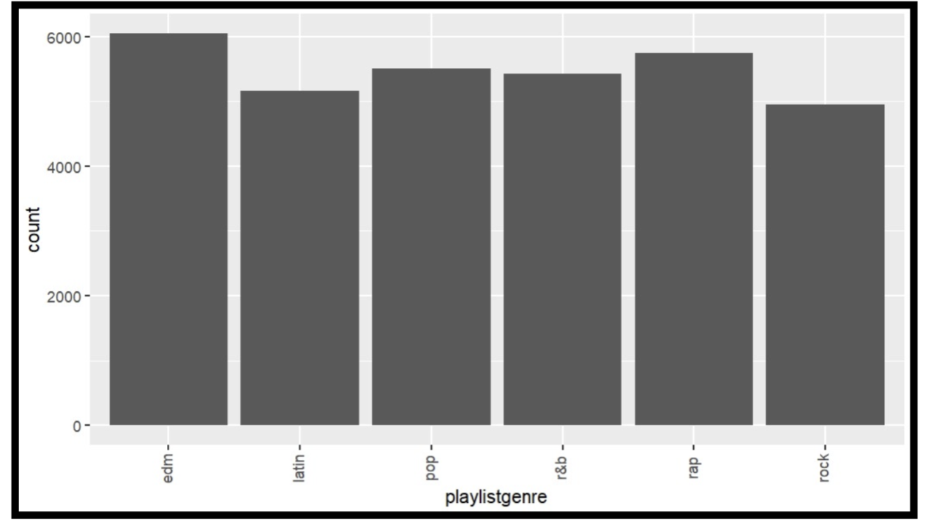
Genre and Subgenre Distribution Analysis
Displayed on the “playlistgenre” graph is the song count distribution across playlist genres—EDM, Latin, Pop, R&B, Rap, and Rock. EDM dominates with the highest song count, trailed by the Latin genre. Pop follows as the third most abundant genre, succeeded by R&B, Rap, and finally Rock.
An analysis reveals a fairly even distribution among genres, with no significant disparities noted.
The ”playlistssubgenre” graph illustrates the song count across various playlist subgenres, with the x-axis representing the subgenre and the y-axis denoting the number of songs.
The most prevalent subgenre, progressive electro house, boasts over 1500 songs, followed closely by pop EDM, hip hop, and Latin pop, each exceeding 1000 songs. Conversely, reggaeton emerges as the least popular subgenre, housing fewer than 1000 songs.
Overall, the distribution among subgenres appears relatively uniform, with minimal variation observed across the graphs.

Slide 10
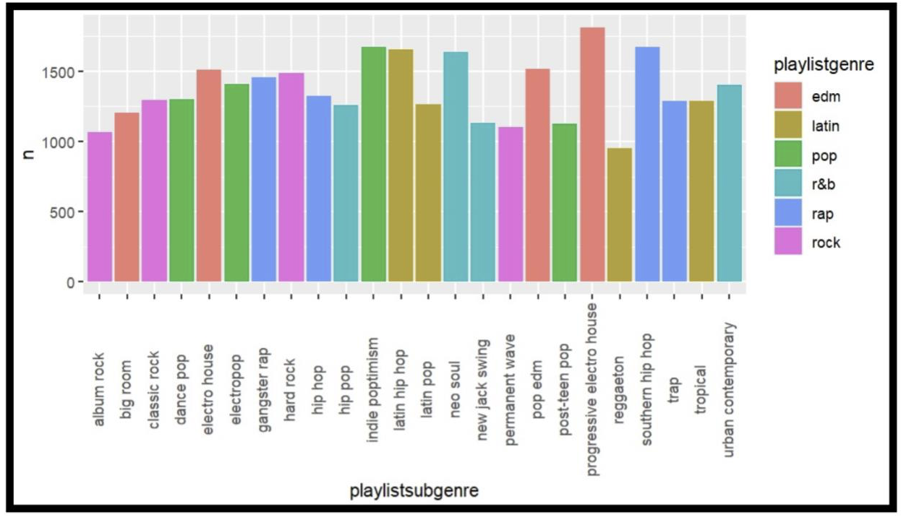
Genre Distribution Analysis
The chart illustrates the song count per genre within the playlist. Genres encompass a diverse range including Album Rock, Big Room, Classic Rock, Dance Pop, Electro House, Electropop, Gangster Rap, Hard Rock, Hip Hop, Indie Poptimism, Latin Hip Hop, Latin Pop, Neo Soul, New Jack Swing, Permanent Wave, Pop EDM, Post-Teen Pop, Progressive Electro House, Reggaeton, Southern Hip Hop, Trap, Tropical, and Urban Contemporary.
The x-axis denotes the song count per genre, while the y-axis represents the genres themselves. Notably, Hip Hop emerges as the most prominent genre, boasting 1500 songs, whereas Progressive Electro House registers the fewest songs at 50.
In summary, the chart underscores the playlist's significant emphasis on Hip Hop, closely followed by Pop EDM and Latin Pop.

Slide 11
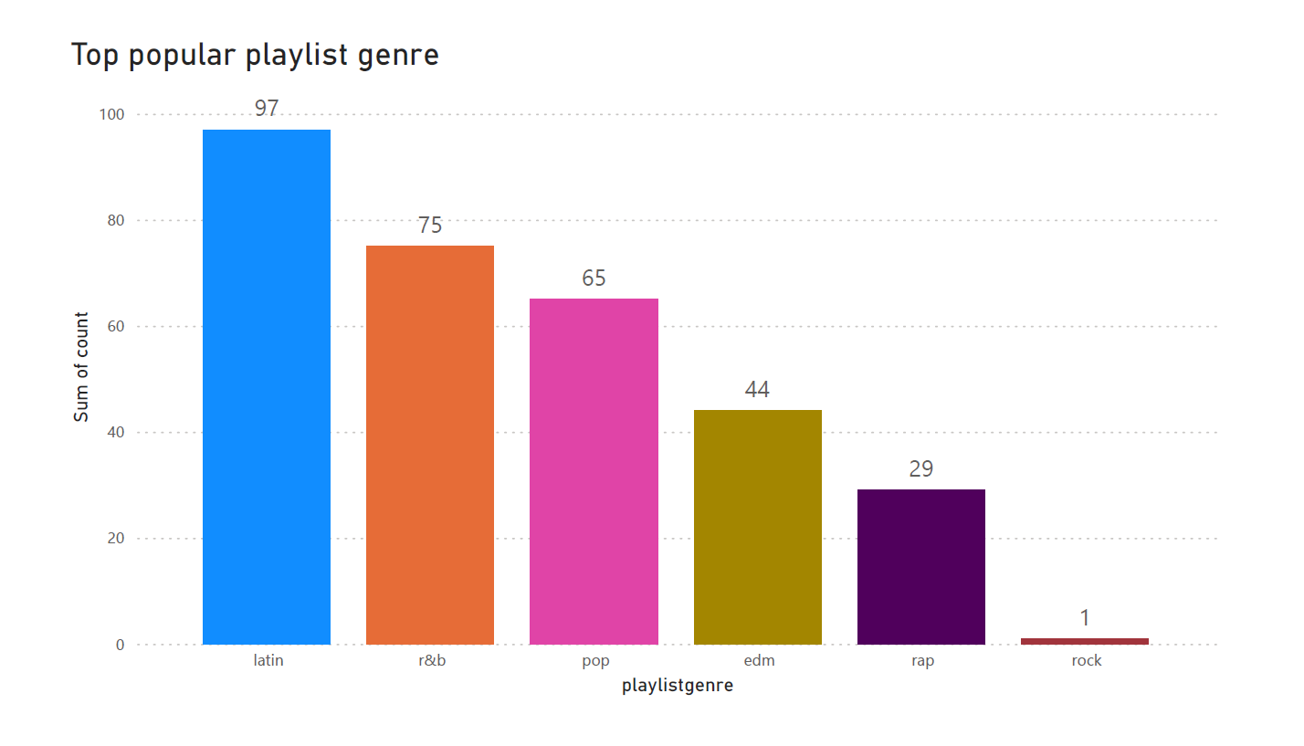
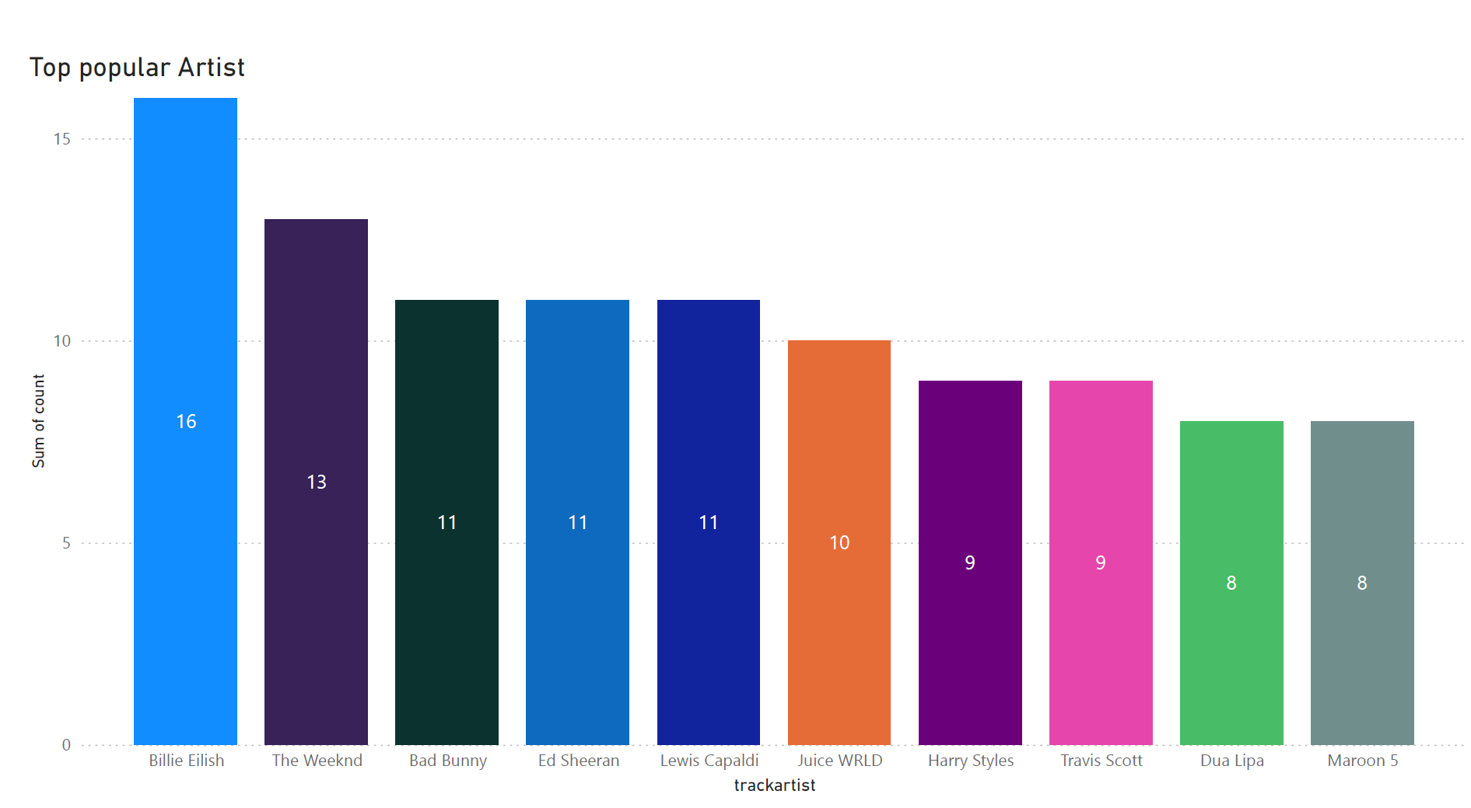
Predictive Analysis

Slide 12
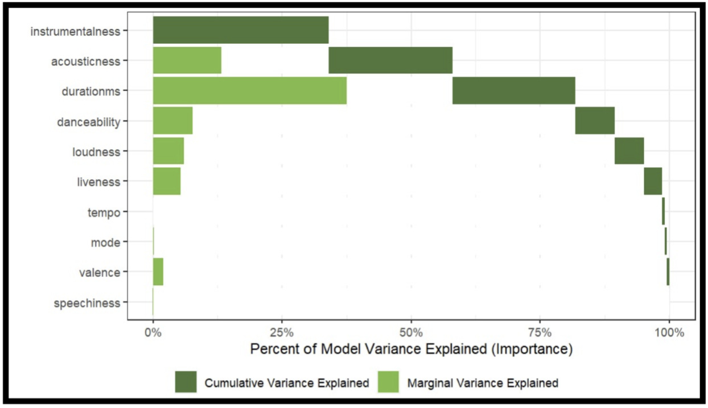
Feature Importance Analysis
The tornado plot showcases the percentage of model variance explained by various features, including Instrumentality, Acousticness, Duration (ms), Danceability, Loudness, Liveness, Tempo, Mode, Valence, and Speechiness.
Key findings indicate that Instrumentality holds the highest explanatory power, accounting for 25% of the model variance, followed by Acousticness (15%) and Duration (ms) (10%). Other features individually contribute less than 10% to the variance.
Additionally, the light shade bars highlight significant relationships between features and song popularity. Notably, Duration (ms) emerges as the most impactful, followed by Danceability, Liveness, Tempo, Mode, Valence, and Speechiness. These insights provide valuable understanding for optimizing models and understanding song popularity dynamics.

Slide 13

Understanding Influences: Factors Shaping Spotify Music Choices
The primary factors influencing an individual's choice of music on Spotify include variables such as track popularity, energy, loudness, tempo, and duration.
These factors were identified through correlation and regression analyses conducted on Spotify songs data. However, it is important to note that other unaccounted variables may also contribute to the overall popularity of songs on Spotify.

Slide 14

Forecasting Musical Shifts: Insights from Spotify Data Analysis
The regression analyses conducted on Spotify songs data revealed significant relationships between certain factors (such as track popularity, energy, loudness, tempo, and duration) and the popularity of songs.
However, despite the significant relationships, the R-squared values were relatively low, indicating that only about 5% of the variability in the popularity of the song could be explained by the independent variables included in the models.
Therefore, while historical data can provide insights into potential shifts in musical preferences, there may be limitations in accurately predicting these shifts due to the presence of unaccounted variables.

Slide 15

Enhancing Engagement: Recommendations for Spotify's Musical Experience
Actionable recommendations to enhance user satisfaction and engagement on Spotify could include refining the recommendation mechanisms within the Spotify app based on the identified factors influencing track popularity. These recommendations may involve optimizing playlist curation and personalized recommendations tailored to different audience segments.
Additionally, further research and analysis may be needed to identify and incorporate other influential variables into the recommendation system to improve its accuracy and effectiveness.

Slide 16
Relevance of Insights: Impact on Spotify and Music Industry
Spotify Team: The findings directly impact Spotify's operations, guiding decisions related to playlist curation, recommendation algorithms, user engagement strategies, and product development. Understanding the factors influencing user preferences helps Spotify optimize their platform to enhance user satisfaction and retention.
Music Industry Professionals: Professionals in the music industry can gain insights into evolving consumer preferences and trends, allowing them to tailor their marketing strategies, artist promotions, and content creation to better resonate with audiences.
Data Analysts and Researchers: Data analysts and researchers benefit from understanding the methodologies and findings of the analysis, which can inform future studies and contribute to the broader understanding of consumer behavior and music consumption patterns.
Marketers: Marketers can leverage insights from the presentation to develop targeted advertising campaigns, partnerships, and promotions that align with the preferences of Spotify users, thereby maximizing the effectiveness of their marketing efforts.

Slide 17

THANK YOU

